Slide 1

Settlement Initiator Processing

Slide 2
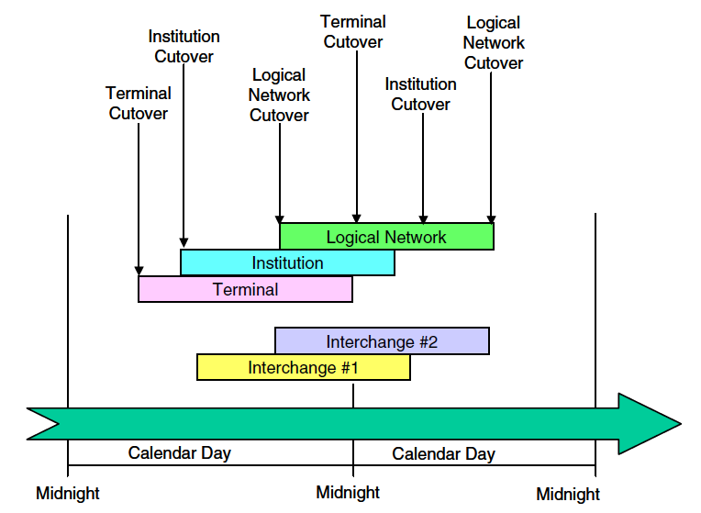
Base24-atm Cutover Hierarchy

Slide 3
Base24-atm Cutover Hierarchy(cont)
All terminals must be cutover before institution cutover.
All institutions must be cutover before logical network cutover.
Logical network cutover defines business day where all institution are cutover to the next day.
Interchange cutover varies from interchange to interchange.

Slide 4
Terminal Cutover
In terminal cutover settlement initiator process increases the posting date in the ATD file by one-day.
It also provides terminal balancing support.
In terminal balance, it updates, settles, and clear terminal totals.

Slide 5
Terminal Cutover(cont)
Terminal cutover configuration can be done by following methods:
  Card Balance and Cutover
  CRT Balance and Cutover
  Settlement Initiator Process Force Cutover

Slide 6
Card Balance and Cutover
Service personnel initiate balance and cutover terminal transaction using card at the terminal.
It must be initiated at the terminal within the cutover window defined in IDF.

Slide 7
CRT Balance and Cutover
An operator can balance and cutover terminal using CRT at the institute.
To do this, the operator uses Device Control Terminal(DCT) screens.
The operator must initiate within the cutover window defined in IDF.

Slide 8
Settlement Initiator Process Force Cutover
Terminal is cutover to a new business day by the end of the terminal cutover window defined in the IDF.
If it is not been cutover to a new business day by the end of the terminal cutover window defined in the IDF the settlement initiator process forces the terminal to cutover.

Slide 9
Institution Cutover
In institution cutover settlement initiator process increase the processing dates for institution in the IDF by one.
Each institution controls its cutover time in IDF by defining a window during which it can cutover to a new business day.

Slide 10
Logical Network Cutover
In logical network cutover the entire logical network moves to a new business day.
It closes the Transaction Log File(TLF) for the day just ended, for extracting and reporting.
The logical network cutover time are defined in the Logical Network Configuration File(LCONF).

Slide 11
Interchange Cutover
Interchange cutover is initiated by BASE24-atm or BASE24-pos Settlement process.
If only one BASE24 product is present, interchange cutover occurs at the same time as BASE24 cutover.
If both BASE24-atm and BASE24-pos are present, the BIC ISO Interface process determines when cutover should occur by comparing the cutover times set in the LCONF for BASE24-atm and BASE24-pos.

Slide 12
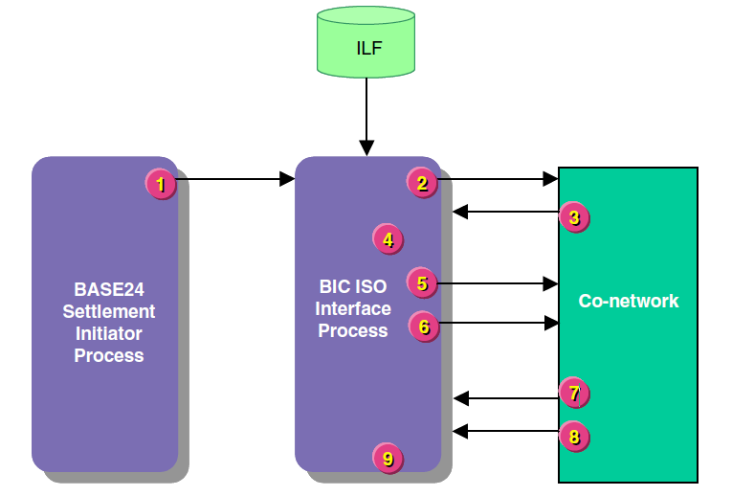
When Interchange is Master

Slide 13
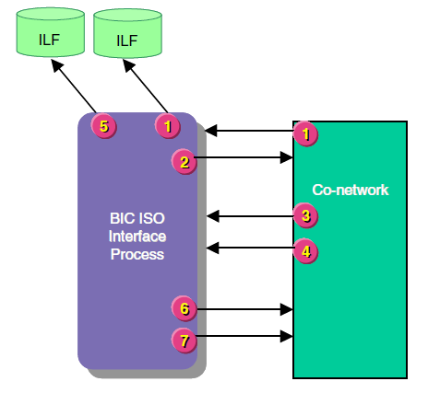
When Interchange is Slave

Slide 14

Settlement Initiator - Initialization
XPNET Process
1. Reads Startup message.
2. Reads name of LCONF into memory.
3. Opens and reads LCONF for assigns
and params.
4. Opens the Token File and builds the
TKN extended memory table to be
used when writing TLF records..
5. Opens the IDF and ATD and TDF.
  builds table of cutover times
6. Retrieves today’s date and computes
tomorrow’s date.
7. Determines if there are existing Report
Files (RPTs) and TLFs for today and
tomorrow. If none exist they will be
created.
Start Node
LCONF
NCS
TKN
IDF
ATD
TDF

Slide 15

Settlement Initiator - Initialization
8. Opens the current day’s TLF.
9. Determines if past LN Cutover:
No - continue
Yes - verifies that all FIs are cut over
10. Initializes timer tables in extended
memory.
11. Sets Cutover Processing Timers:
  FI Cutover Timer
  Midnight Cutover Timer
  Force Cutover Timer
  LN Cutover Timer
  Start Reports Timer
  Terminal Timer
12. Initializes Network Logging Facility.
13. Reads LMCF for modified log
messages.
TLF
EMS
LMCF

Slide 16




Settlement Initiator - Cutover Timers
TERMINAL CUTOVER
  ATM Terminal Balance and Cutover Time Window
  Force Cutover Timer
FINANCIAL INSTITUTION CUTOVER
  ATM Terminal Balance and Cutover Window
LOGICAL NETWORK CUTOVER
  ATM-LN-CUTOVER
  ATM-LN-CUTOVER-LEAD-TIME
IDF
IDF
LCONF

Slide 17
Settlement Initiator -
Financial Institution Cutover
1. FI Cutover Timer expires.
2. Reads ATD and TDF for FIID.
3. Force balances DISK ATD/TDF records for all terminals.
  BAL FLAG = 9 (forced balance)
  POST DATE = next calender date
  Sends BAL records to TLF
4. Sends message to logging facility.
5. Reads IDF for FI being cut over.
6. Purges data in the UAF, if required.
7. Advances RPT-BUS-DAT to CUR-BUS-DAT.
TDF
ATD
TLF
EMS
IDF
UAF

Slide 18
Settlement Initiator -
Financial Institution Cutover
8. Advances CUR-BUS-DAT to NXT-BUS-DAT.
9. Advances NXT-BUS-DAT by 1 day.
10. Updates CUST-PROC-DAT, if required.
11. Establishes new withdrawal period and resets BEG-DAT and NEX-BEG-DAT fields, if required.
12. Writes IDF record back to the file.
IDF

Slide 19
Settlement Initiator - Force Cutover
15 Minutes Prior to LN Cutover
1. Force Cutover Timer expires.
2. Retrieves each Terminal Timer that is still running.
3. Reads ATD and TDF records. (from disk to memory)
4. Sets BALANCE FLAG field to 9 (Forced).
5. Changes POSTING DATE to next calendar date.
6. Creates balancing records and writes them to current day’s TLF.
7. Sends message to logging facility.
8. Writes ATD or TDF record back to disk.
ATD
ATD/TDF
TLF
EMS

Slide 20
Settlement Initiator -
Logical Network Cutover
1. Logical Network Cutover Timer expires.
2. Closes the current day’s TLF.
3. Increases NEXT BUSINESS DATE by 1.
4. Broadcasts cutover message (9502) to processes in ATM-NOTIFY list.
5. Checks to see if reports must be started.
If YES: Report obey files are created
If NO: No obey files are created
6. Purges old RPT files.
7. Purges old TLF files.
8. Purges old report obey files.
“Current”
TLF

Slide 21
Settlement Initiator -
Logical Network Cutover
9. Creates DAY AFTER NEXT TLFs. (Primary and Alternate key files)
10. Generates log message “Cutover Completed for YYMMDD”.
11. Increases dates in internal memory fields for current day and next day.
12. Opens new current day’s TLF.
13. Deallocates unused TLF space.
14. Resets Timers:
- Logical Network Cutover Timer
- FI Cutover Timer
- Force Cutover Timer
- Midnight Cutover Timer, if required
“Next”
TLF
TLF

Slide 22
Documents to Refer
ATM Settlement and Reporting Manual
Settlement
and Reporting
Manual

Slide 23
Thank You

